Slide 2
PRESENTATION MAP
Part 1: Data Dissemination
Sources of data to be disseminated
Platform for data dissemination
Public accessibility
Part 2: Data to enhance communication
From Disseminating to Communicating
Our communicational tools and tactics
Specific Techniques and Guard Rails

Slide 3
PART 1
Data Dissemination Online: Experience with our Platforms

Slide 4
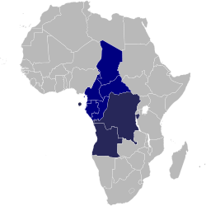
Sources of Data to be disseminated
Macroeconomic data from BEAC for CEMAC countries (Cameroon, Central African Republic, Chad, Congo, Equatorial Guinea, and Gabon)
IMF data for ECCAS countries (Angola, Burundi, Democratic Republic of Congo, Sao Tome and Principe)
MDG data
Data from National Statistical Offices
ECA country focal points
Data from other sources (World Bank,
ILO, OECD, European Commission, etc.)

Slide 5
Platform for data dissemination
Website (Central African StatBase)
Publications (Economies of Central African countries)
Country Profiles (quarterly)
Special Reports (MDG, Regional trade, etc.)

Slide 6
Public accessibility
Website (Central African StatBase) is the preferred data dissemination tool
Currently only accessible to staff members
Will soon be accessible to all via Internet

Slide 7
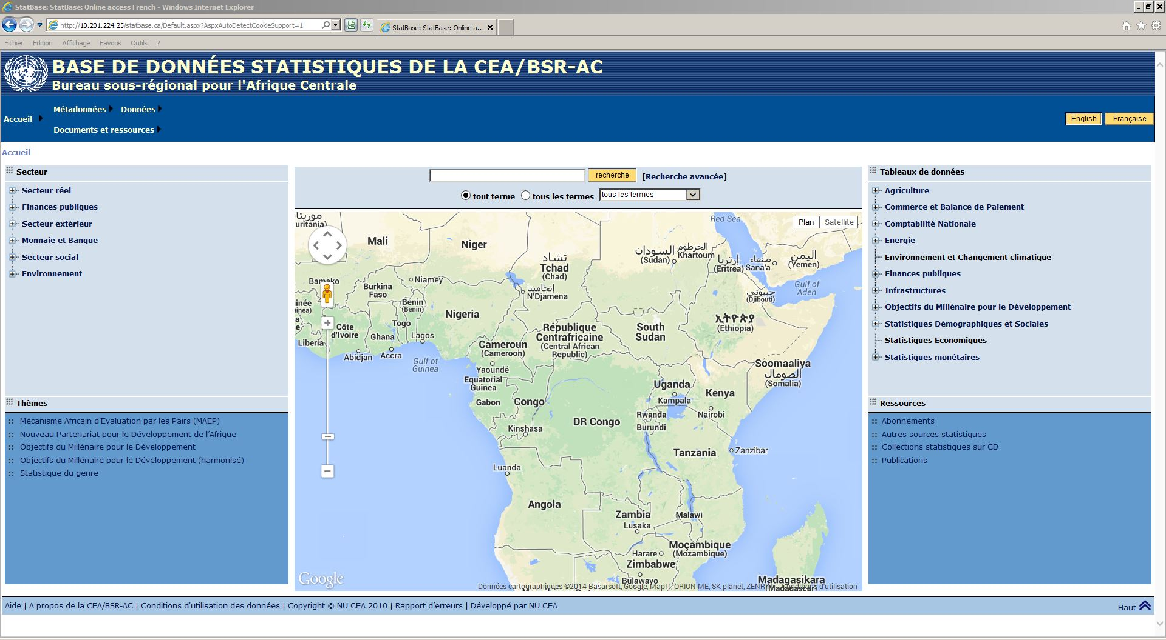
Homepage of the Central African StatBase

Slide 8
Perspective
Data dissemination will be centralized in the new ECA databank architecture
SRO-CA will need to be able to get more data from NSOs
SRO-CA will need customized database interface to import data from external data sources, e.g. BEAC

Slide 9
PART 2
Using data to enhance
our online Communication

Slide 10
From Disseminating to Communicating

Slide 11
Our communicational tools and tactics

Slide 12
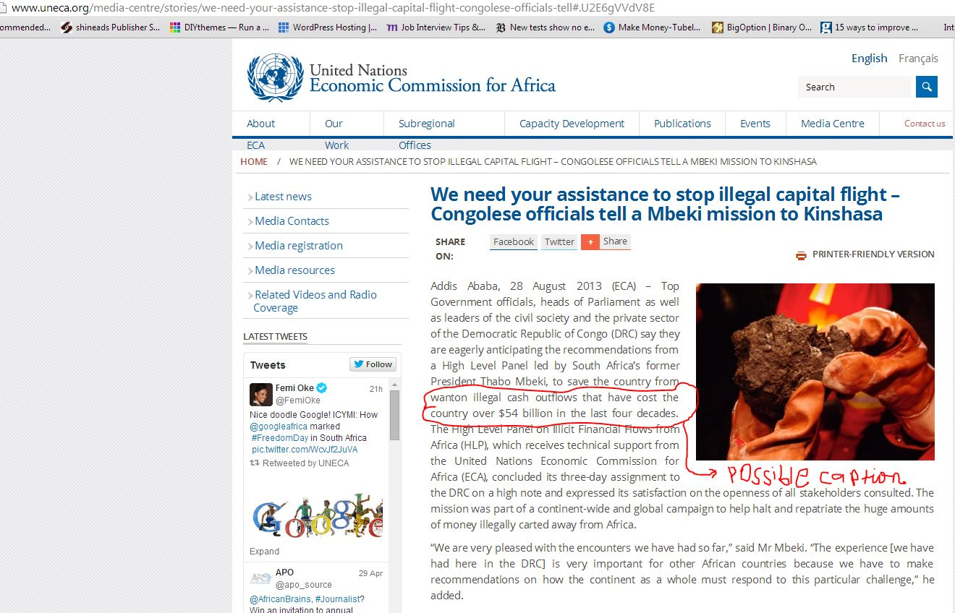
Our communicational tools and tactics
News Releases

Slide 13
Our communicational tools and tactics
Newsletters

Slide 14
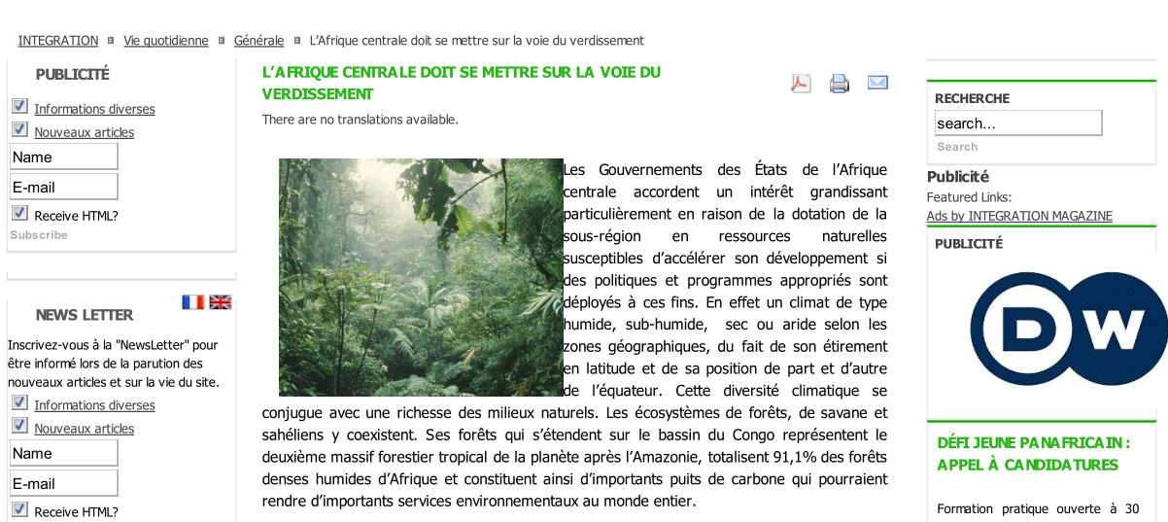
Our communicational tools and tactics
Blogs and opinion editorials

Slide 15
Our communicational tools and tactics
Infographics

Slide 16
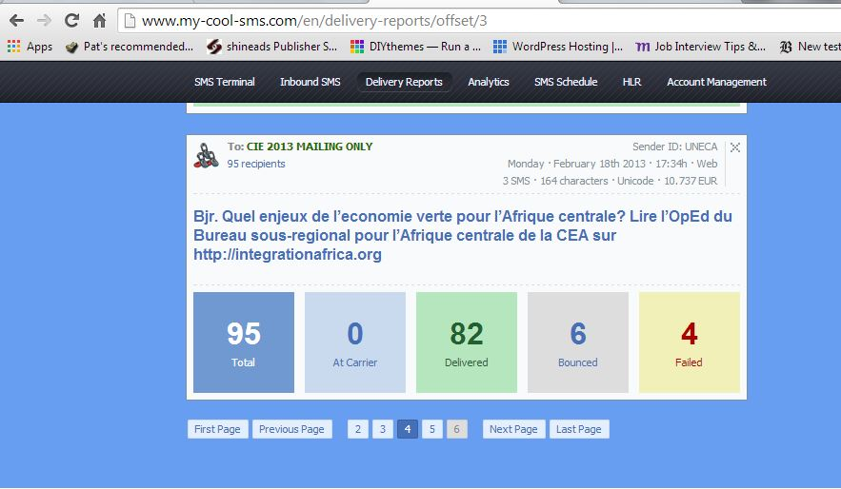
Our communicational tools and tactics
Bulk smses for website redirecting

Slide 17
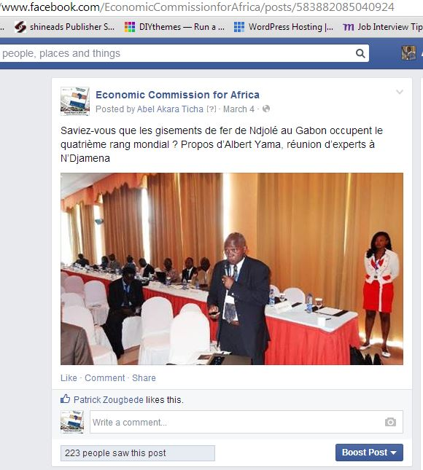
Our communicational tools and tactics
Social media

Slide 18
Our communicational tools and tactics
Social media CT’D

Slide 19
Specific Techniques and Guard Rails

Slide 20
THANK YOU
MERCI

